Slide 1
On Problems Quantum Computers Can Solve Efficiently
(FEE2026)
09/10/2026
Vu Tuan Hai, UIT-VNUHCM

Slide 2
Outline
Quantum complexity theory
Representative algorithms (Grover's algo)
Sources of quantum advantage
Quantum machine learning bottlenecks.

Slide 3
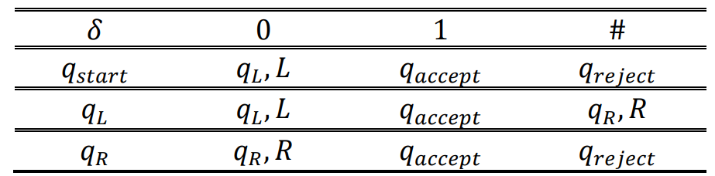


Deterministic
Deterministic Turing machine $M=\{Q,Σ,q_{start},q_{reject},q_{accept},δ\}$
$$Q=\{States\}$$
$$Σ=\left\{Alphabelt\right\}=\{0,1,\#\}$$
$δ=Q × Σ→Q × Σ × \{L, R\}$ (transition function)
Notes:
Q x xichma x {L, R} is a function

Slide 4
Nondeterministic
Guessing module
Reader
Write - only head
Read – write head
# | 0 | 0 | 0 | 0 | 0 | 1 | #
Tape

Slide 5
Nondeterministic
Nondeterministic Turing machine $M=\{Q,Σ,q_{start},q_{reject},q_{accept},δ\}$
$δ=Q × Σ→𝒫(Q × Σ × \left\{L, R\right\})$, $𝒫(S)$ denotes for power set of $S$
If the problem is solvable in polynomial time by a non-deterministic Turing machine, the problem belongs to NP class

Slide 6






Deterministic
Nondeterministic
$$f(n)$$
$$q_{reject}$$
$$q_{accept}$$
…
…
$$q_{accept}/q_{reject}$$
$$q_{accept}$$
1 computation path
$n$ computation path

Slide 7

Example: Sub-set sum problem
Given a set S = $\{1,−2, 5,3\}$. What sub-set of S has sum equal 7?

Slide 8











Deterministic
Nondeterministic
$$\{1\}$$
$$\{1\}$$
$$\{−2\}$$
$$\{5\}$$
$$\{3\}$$
$$\{−2\}$$
…
$$\{1,5,3\}$$
…
$$\{1,−2,5,3\}$$
$$q_{accept}$$
$$\{1,−2,5,3\}$$
$$q_{accept}$$
S = $\{1,−2, 5,3\}$.

Slide 9
Polynomial number of SPACE
PSPACE
Kiểm tra lời giải trong thời gian đa thức
Nonderterministic Turing machine in Polynomial number of step
NP
coNP
complement of NP
Cho một tập hợp các số nguyên, có phải tất cả tập hợp con đều có tổng khác T không?
Cho một tập hợp các số nguyên, tồn tại hay không một tập hợp con có tổng bằng T không?
P = coP
Polynomial number of step
Tồn tại lời giải trong thời gian đa thức
Notes:
Q x xichma x {L, R} is a function

Slide 10
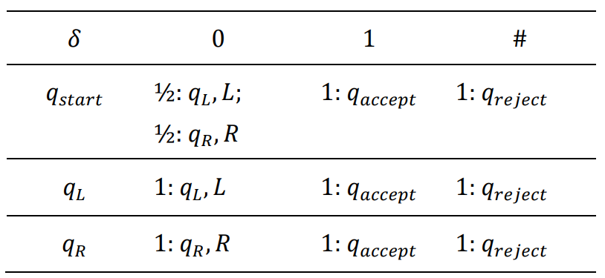
Probability
Nondeterministic Turing machine $M=\{Q,Σ,q_{start},q_{reject},q_{accept},δ\}$
$$δ=Q × Σ→{\left[0,1\right]}^{(Q × Σ × \left\{L, R\right\})}$$

Slide 11
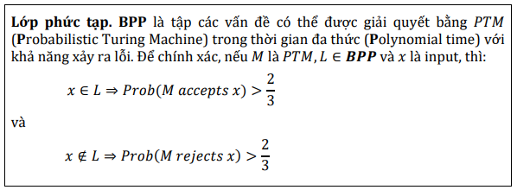
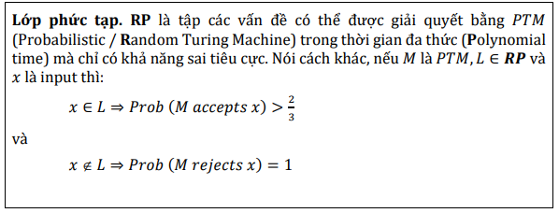









Probability
Tính hội tụ!
Lời giải đúng
Chấp nhận lời giải đúng
$$0.14$$
$$(q_{9},σ_{2},L)$$
$$0.23$$
$$(q_{17},σ_{18},R)$$
$$(q_{6},σ_{16})$$
$$(q_{17},σ_{18},R)$$
$$0.08$$
$$(q_{21},σ_{23},L)$$
$$0.55$$

Slide 12

Probability
PSPACE
Probabilistic Turing Machine in Polynomial time với khả năng xảy ra lỗi
BPP
NP
BPP
coNP
Probabilistic / Random Turing Machine in Polynomial time with false positive only
RP
coRP
Probabilistic / Random Turing Machine in Polynomial time with false negative only
RP
coRP
ZPP
ZPP = RP $∩$ coRP
Probabilistic / Random Turing Machine in Polynomial time with Zero error, allow ? result
P

Slide 13
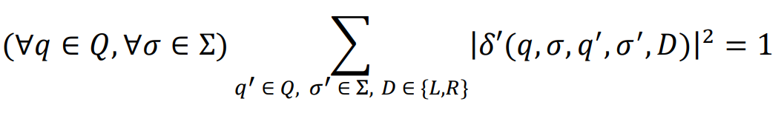
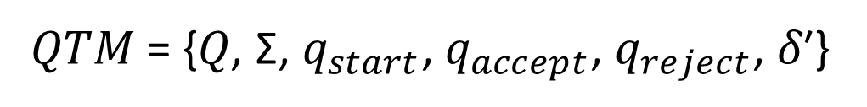

Quantum
Quantum Turing machine $M=\{Q,Σ,q_{start},q_{reject},q_{accept},δ\}$
𝑄𝑇𝑀 = {𝑄, Σ, $q_{start}$, $q_{accept}$, $q_{reject}$, 𝛿′}
𝛿′: 𝑄 × 𝛴 × 𝑄 × 𝛴 × {𝐿, 𝑅} → ℂ

Slide 14
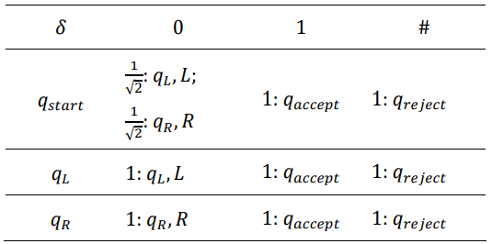
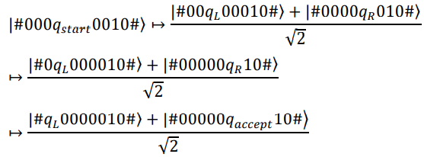
Quantum

Slide 15
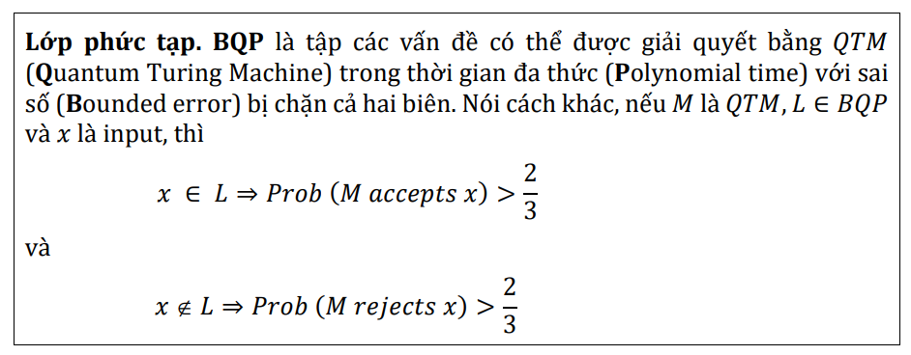
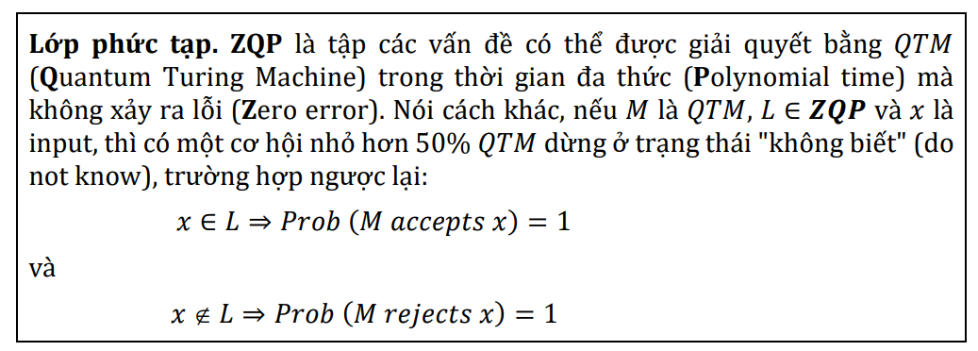
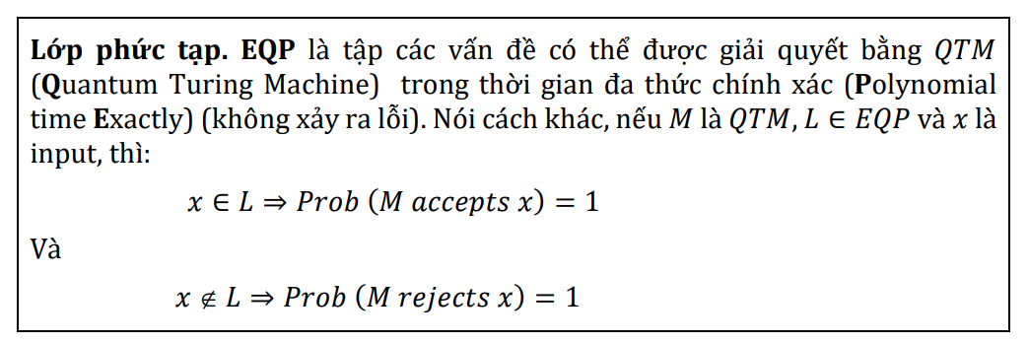
Quantum
Simon, Grover
𝑬𝑸𝑷 ⊆ 𝒁𝑸𝑷 ⊆ 𝑩𝑸𝑷
Same as ZPP
Deutsch-Jozsa,
Require only 1 query

Slide 16
Quantum
PSPACE
BQP
NP
coNP
Quantum Turing Machine in Polynomial time with Bounded error (sai số bị chặn)
BPP
ZQP
Quantum Turing Machine in Polynomial time with Zero error
EQP
RP
coRP
Quantum Turing Machine in Polynomial Exactly time with no error
ZPP
P

Slide 17

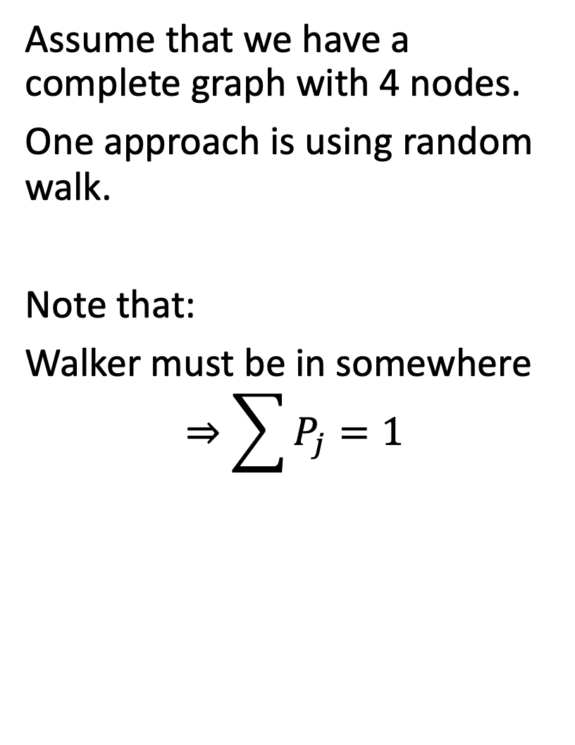
Spatial search (discrete time)
2. Grover algo
1
Assume that we have a complete graph with 4 nodes.
One approach is using random walk.
Note that:
Walker must be in somewhere
$$⇒\sum{P_{j}=1}$$
4
2
3

Slide 18
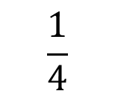

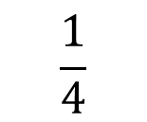
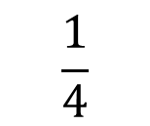
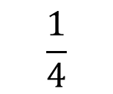
Random walk
$$\frac{1}{4}$$
1
Initial state: ¼ at all node
At step k: jump to other random nodes
$P_{1}=P_{2}=P_{3}=P_{4}=1/4$
Acts as absorb node
$$\frac{1}{4}$$
4
2
$$\frac{1}{4}$$
3
$$\frac{1}{4}$$

Slide 19
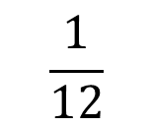
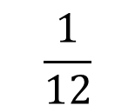
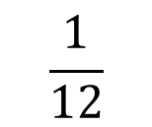
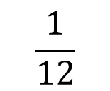
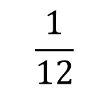
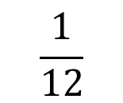
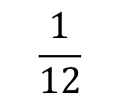
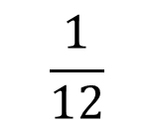
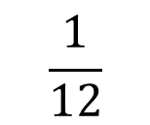
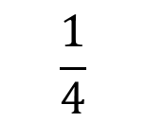
Random walk
$$\frac{1}{12}$$
$$\frac{1}{12}$$
1
At step 1:
$$\frac{1}{12}$$
$$\frac{1}{12}$$
$$\frac{1}{12}$$
4
2
$$\frac{1}{4}$$
$$\frac{1}{12}$$
$$\frac{1}{12}$$
3
$$\frac{1}{12}$$
$$\frac{1}{12}$$

Slide 20
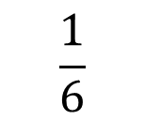
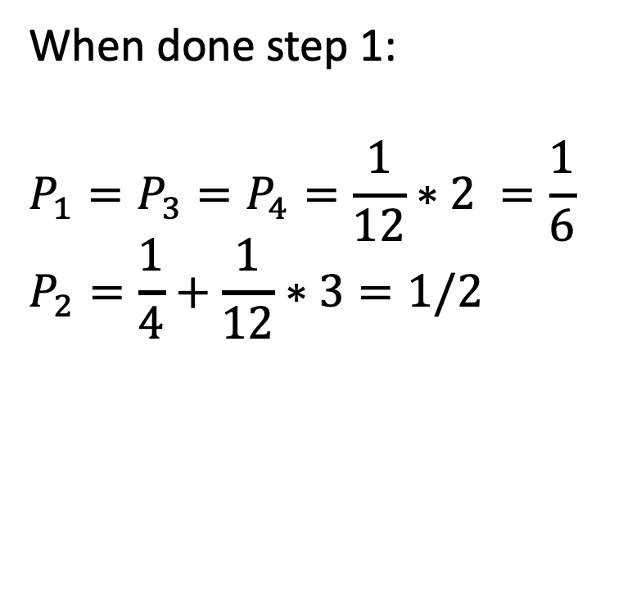
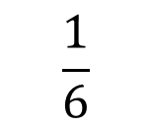
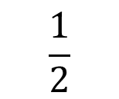
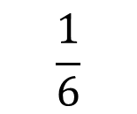
Random walk
$$\frac{1}{6}$$
1
When done step 1:
$$P_{1}=P_{3}=P_{4}=\frac{1}{12}∗2 =\frac{1}{6}$$
$$P_{2}=\frac{1}{4}+\frac{1}{12}∗3=1/2$$
$$\frac{1}{6}$$
4
2
$$\frac{1}{2}$$
3
$$\frac{1}{6}$$

Slide 21
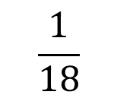
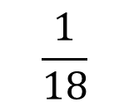
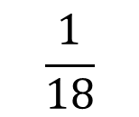
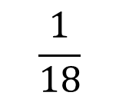
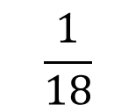
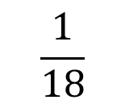
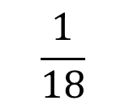
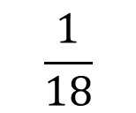
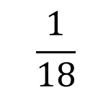
Random walk
$$\frac{1}{18}$$
$$\frac{1}{18}$$
1
At step 2:
$$\frac{1}{18}$$
$$\frac{1}{18}$$
$$\frac{1}{18}$$
4
2
$$\frac{1}{2}$$
$$\frac{1}{18}$$
$$\frac{1}{18}$$
3
$$\frac{1}{18}$$
$$\frac{1}{18}$$

Slide 22
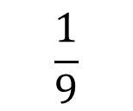
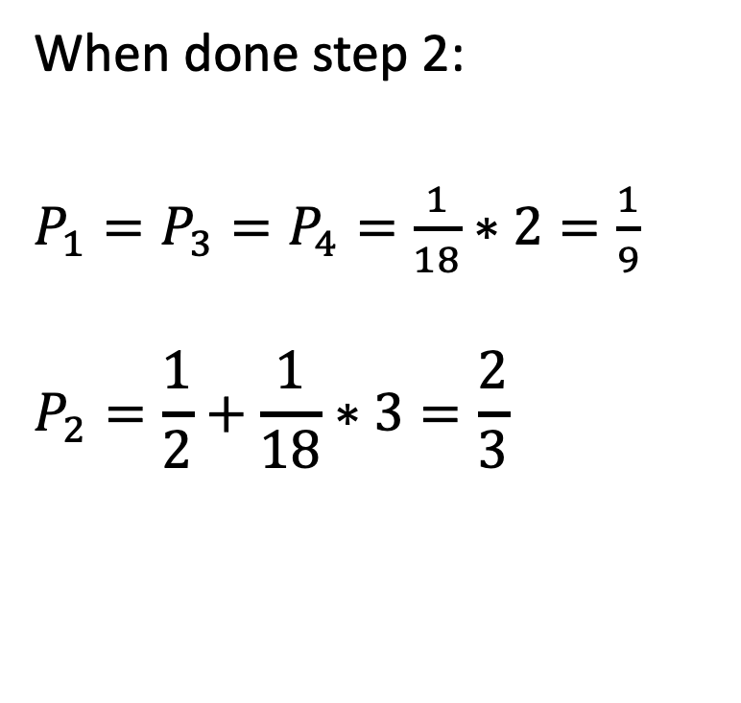
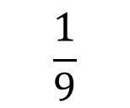
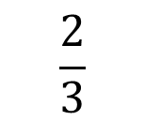
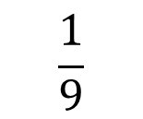
Random walk
$$\frac{1}{9}$$
1
When done step 2:
$P_{1}=P_{3}=P_{4}=\frac{1}{18}∗2=\frac{1}{9}$
$$P_{2}=\frac{1}{2}+\frac{1}{18}∗3=\frac{2}{3}$$
$$\frac{1}{9}$$
4
2
$$\frac{2}{3}$$
3
$$\frac{1}{9}$$

Slide 23
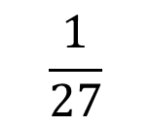
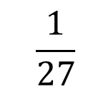







Random walk
$$\frac{1}{27}$$
$$\frac{1}{27}$$
1
At step 3:
$$\frac{1}{27}$$
$$\frac{1}{27}$$
$$\frac{1}{27}$$
4
2
$$\frac{2}{3}$$
$$\frac{1}{27}$$
$$\frac{1}{27}$$
3
$$\frac{1}{27}$$
$$\frac{1}{27}$$

Slide 24





Random walk
$$\frac{2}{27}$$
1
When done step 3:
$$P_{1}=P_{3}=P_{4}=\frac{1}{27}∗2=\frac{2}{27}$$
$$P\left(2\right)=\frac{2}{3}+\frac{1}{27}∗3=\frac{7}{9}$$
$$\frac{2}{27}$$
4
2
$$\frac{7}{9}$$
3
$$\frac{2}{27}$$

Slide 25


Random walk
Prob(Success) at time t = $1−\frac{N−1}{N}{\left(\frac{N−2}{N−1}\right)}^{t}$
Runtime: $O(N)$

Slide 26













Quantum walk
$$α_{14}$$
1
$$α_{12}$$
Change 4 probs to 12 amplitudes of a wave function $\left|ψ\right\rangle ≔\{α_{i}\}$
Init: $|ψ(0)⟩$
Note that at intermediate steps we cannot observe the system. Then we do not know the current node is the marked node or not.
$$α_{41}$$
$$α_{21}$$
$$α_{13}$$
4
2
$$α_{42}$$
$$α_{24}$$
$$α_{31}$$
$$α_{43}$$
$$α_{23}$$
3
$$α_{34}$$
$$α_{32}$$

Slide 27














Quantum walk
At node 2: A = $\frac{−1}{\sqrt{12}}∗\frac{3}{3}$
$$\frac{1}{\sqrt{12}}$$
$$\frac{1}{\sqrt{12}}$$
1
At step 1
1a. Query oracle:
$$Q|ψ\left(0\right)⟩$$
1b. Apply a quantum coin flip+shift (-I+2A) that inverts each amplitude about the average amplitude at its vertex. (Nothing happen)
$$C(Q|ψ\left(0\right)⟩)$$
$$\frac{1}{\sqrt{12}}$$
$$−\frac{1}{\sqrt{12}}$$
$$\frac{1}{\sqrt{12}}$$
$$\frac{1}{\sqrt{12}}$$
$$−\frac{1}{\sqrt{12}}$$
2
4
$$\frac{1}{\sqrt{12}}$$
$$\frac{1}{\sqrt{12}}$$
$$−\frac{1}{\sqrt{12}}$$
3
$$\frac{1}{\sqrt{12}}$$
$$\frac{1}{\sqrt{12}}$$

Slide 28







Quantum walk
$$\frac{1}{\sqrt{12}}$$
$$−\frac{1}{\sqrt{12}}$$
1
1c. Shift operator (walk): walker at vertex i pointing to vertex j to hop to vertex j and point back to vertex i $⇒$ Swap $α_{ij}$ with $α_{ji}$.
$$SCQ\left|ψ\left(0\right)\right\rangle =|ψ\left(1\right)⟩$$
$$\frac{1}{\sqrt{12}}$$
$$\frac{1}{\sqrt{12}}$$
$$−\frac{1}{\sqrt{12}}$$
$$\frac{1}{\sqrt{12}}$$
$$\frac{1}{\sqrt{12}}$$
2
4
$$\frac{1}{\sqrt{12}}$$
$$\frac{1}{\sqrt{12}}$$
$$\frac{1}{\sqrt{12}}$$
3
$$\frac{1}{\sqrt{12}}$$
$$−\frac{1}{\sqrt{12}}$$

Slide 29

Quantum walk
$$\frac{1}{\sqrt{12}}$$
$$−\frac{1}{\sqrt{12}}$$
1
At step 2
2a. Query oracle:
$$Q|ψ\left(1\right)⟩$$
$$\frac{1}{\sqrt{12}}$$
$$−\frac{1}{\sqrt{12}}$$
$$−\frac{1}{\sqrt{12}}$$
$$\frac{1}{\sqrt{12}}$$
$$−\frac{1}{\sqrt{12}}$$
2
4
$$\frac{1}{\sqrt{12}}$$
$$\frac{1}{\sqrt{12}}$$
$$−\frac{1}{\sqrt{12}}$$
3
$$\frac{1}{\sqrt{12}}$$
$$−\frac{1}{\sqrt{12}}$$

Slide 30


Quantum walk
Reflected amp
2b. The coin inverts or reflects each amplitude about their average.
(-I+2A)
At node 1: $A=\frac{\frac{1}{\sqrt{12}}+\frac{1}{\sqrt{12}}−\frac{1}{\sqrt{12}}}{3}=\frac{1}{6\sqrt{3}}$
$$⇒α_{12}=−α_{12}+2A=\frac{5}{6\sqrt{3}}$$
$$⇒α_{13}=−α_{13}+2A=\frac{−1}{6\sqrt{3}}$$
Current amp

Slide 31













Quantum walk
$$\frac{−1}{6\sqrt{3}}$$
$$\frac{5}{6\sqrt{3}}$$
1
2c. Shift operator (walk): swap $α_{ij}$ with $α_{ji}$.
$$\frac{−1}{6\sqrt{3}}$$
$$−\frac{1}{2\sqrt{3}}$$
$$\frac{−1}{6\sqrt{3}}$$
$$−\frac{1}{2\sqrt{3}}$$
4
2
$$\frac{5}{6\sqrt{3}}$$
$$\frac{−1}{6\sqrt{3}}$$
$$\frac{−1}{6\sqrt{3}}$$
$$−\frac{1}{2\sqrt{3}}$$
3
$$\frac{−1}{6\sqrt{3}}$$
$$\frac{5}{6\sqrt{3}}$$

Slide 32











Quantum walk
$$\frac{11}{108}$$
$$\frac{−1}{6\sqrt{3}}$$
$$−\frac{1}{2\sqrt{3}}$$
1
2c. Shift operator (walk): swap $α_{ij}$ with $α_{ji}$.
$$\frac{−1}{6\sqrt{3}}$$
$$\frac{5}{6\sqrt{3}}$$
$$−\frac{1}{2\sqrt{3}}$$
$$\frac{−1}{6\sqrt{3}}$$
$$\frac{5}{6\sqrt{3}}$$
2
$$\frac{11}{108}$$
4
$$\frac{25}{36}$$
$$\frac{−1}{6\sqrt{3}}$$
$$\frac{−1}{6\sqrt{3}}$$
$$\frac{5}{6\sqrt{3}}$$
3
$$\frac{−1}{6\sqrt{3}}$$
$$−\frac{1}{2\sqrt{3}}$$
$$\frac{11}{108}$$

Slide 33




Quantum walk
Prob(Success) at time t =
Runtime: $O(\sqrt{N})$
N=4
N=100

Slide 34

3. Sources of quantum advantage
Largely it comes from superposition.
Look Deutsh-Josza algorithm

Slide 35

3. Sources of quantum advantage
Largely it comes from superposition.
Look Shor’s algorithm

Slide 36

3. Sources of quantum advantage
Total runtime = $T_{prepare}$(build a useful representation) + $T_{solve}$(find the solution).
Recent quantum algorithms: $T_{prepare}≫T_{solve}$
The right benchmark is the strongest available classical workflow, heuristics included - not an idealized worst case.
Q: “Can quantum give speedups under the same heuristic assumptions classical methods use?”

Slide 37


3. Source of Advantage: example in quantum simulation
Classical
  Must store $d^{n}$ complex amplitudes explicitly.
  Matrix–vector multiplication scales as $O(d^{2n})$.
Quantum
  Represents the same Hilbert space with only $n$ qubits.
  Under efficient block encodings, cost can scale as $O(poly(n))$; storage becomes $O(n)$.

Slide 38


3. Source of Advantage: locality and light cone
We usually solving the eigenvalue problem:
    $\hat{H}c=Ec$
$\hat{H}$ is sparsity => ok, solvable on classical computer
But ${\hat{H}}^{k}$ generate a light-cone structure. We must to use resources for saving correlation information
$L_{c}∼nR_{c}$, where $n$ is the number of iterations and $R_{c}$ denotes the interaction range. Consequently, $N_{corr}∼(nR_{c})^{mD}=L_{c}^{mD}$ where $D$ is the physical dimension of the system.
The resulting quantum advantage is approximately $\begin{matrix}\frac{T_{C}}{T_{Q}}∼\frac{L_{c}^{mD}}{T_{BE}},\end{matrix}$

Slide 39

Bottleneck: Data Preparation
Classical data must first be converted into quantum state
A $N$ – dim classical vector may need only $𝒪(log⁡N)$ qubits.
Without QRAM, state-preparation cost can scale badly enough to eliminate any theoretical speedup entirely.
Block encoding: QSVT and Hamiltonian simulation assume a unitary that embeds a matrix - constructing it is often non-trivial and costly for dense matrices.

Slide 40

4. Limitations of Quantum Machine Learning
QML is one of the most actively studied topics, with many claimed advantages over classical ML.
Small-scale evidence: reported gains often come from small experiments or idealized simulations, not current noisy hardware.
Hidden data cost: many claimed speedups neglect the cost of data preparation, building the block encoding can cost more than solving the problem classically.
Idealized access: complexities like $𝒪(poly log⁡n)$frequently assume access models that hide real data-acquisition and encoding costs.

Slide 41
Which problems do quantum computers solve efficiently?
A quantum speedup must be judged end-to-end — not by the quantum portion alone.
Quantum simulation, condensed matter physics, and quantum chemistry offer the most near-term opportunities.
For QML, the bottleneck is typically converting classical data into quantum-ready form, not the circuit itself.

Slide 42




